Slide 1

CS302 Design and Analysis of Algorithms
Muhammad sohail afzal

Slide 2
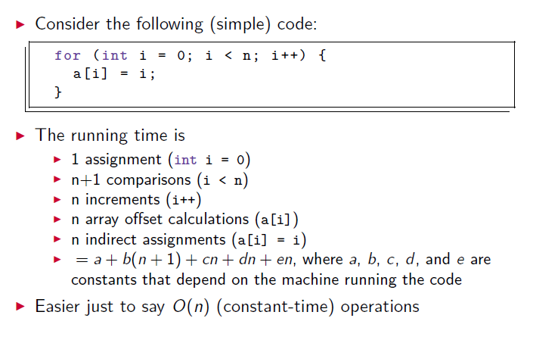
Asymptotic Notations - Why
Why use asymptotic notations ? Or lets say why use Big O notation ?

Slide 3
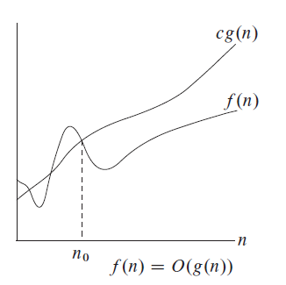
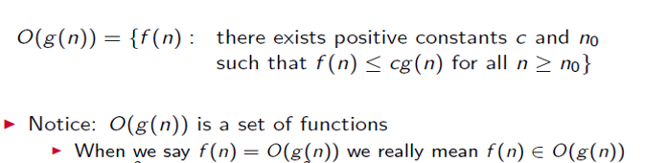
Asymptotic Notations - Big O Overview
Definition:

Slide 4
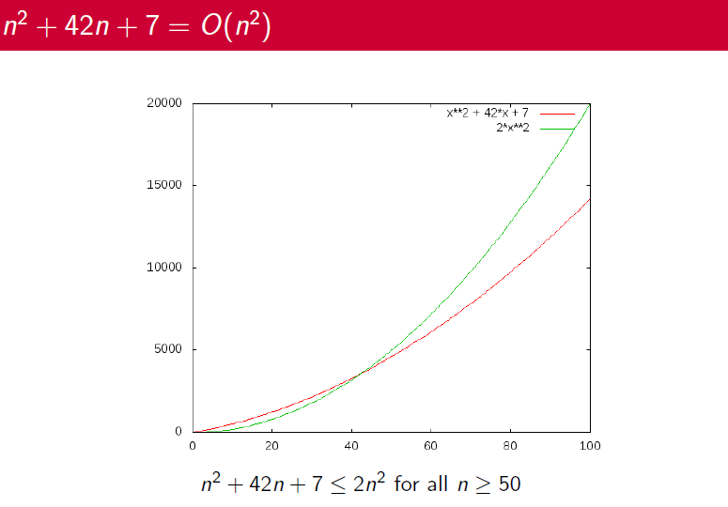
Asymptotic Notation - Big O Overview

Slide 5
Example : Development of Notation for Big O
Not concerned with small values of n
Concerned with VERY LARGE values of n
Example: f(n) = n²+4n + 20
n² is the dominant term and the term 4n + 20 becomes insignificant as n grows larger

Slide 6
Example : Development of Notation for Big O
Drop insignificant terms and constants
Say function is of O(n²) called Big-O of n²
Common Big-O functions in algorithm analysis
g(n) = 1 (growth is constant)
g(n) = log ₂ n (growth is logarithmic)
g(n) = n (growth is linear)
g(n) = n log ₂ n (growth is faster than linear)
g(n) = n² (growth is quadratic)
g(n) = 2^{n} (growth is exponential)

Slide 7
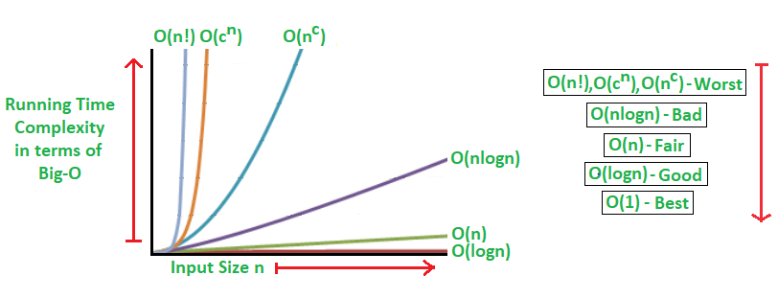
Example :Common Big O functions growth

Slide 8
Example : Common Big O functions growth
n | log2n | nlog2n | n^2 | 2^n
1 | 0 | 0 | 1 | 2
2 | 1 | 2 | 4 | 4
4 | 2 | 8 | 16 | 16
8 | 3 | 24 | 64 | 256
16 | 4 | 64 | 256 | 65536
32 | 5 | 160 | 1024 | 4294967296

Slide 9
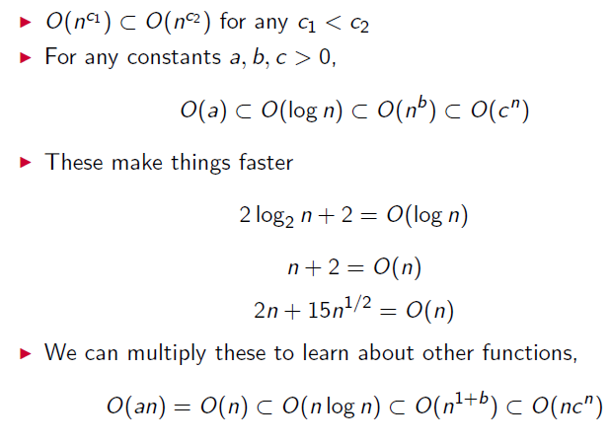
Asymptotic Notation - Big O Overview
Some Common Relations :

Slide 10
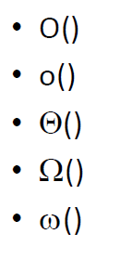
Asymptotic Notations
Mathematical way of representing time complexity of algorithms
Asymptotic – refers to study of function f as n approaches infinity
We use following asymptotic notations :

Slide 11
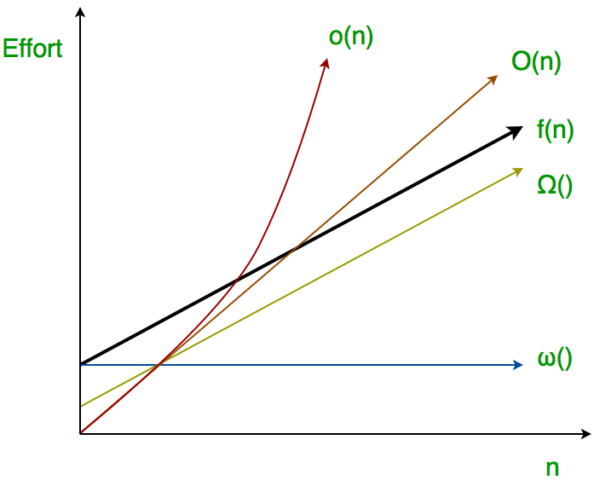
Asymptotic Notations
Big O (Worst case time, tight upper bound, at most amount of time)
Small o (loose upper bound, rough estimate of order of growth)
Big Theta (average time, both upper bound and lower bound, at most and at least time)
Big Omega (best case time, tight lower bound, at least amount of time)
Small Omega (loose lower bound, rough estimate of order of growth)

Slide 12
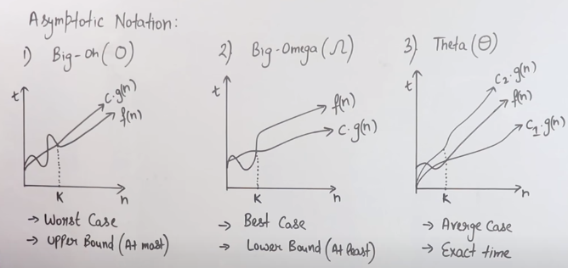
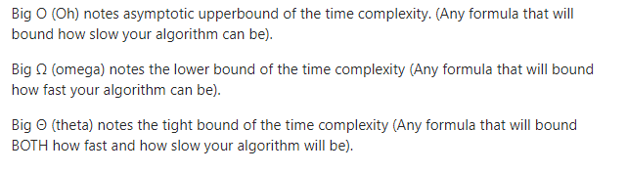
Big O, Big Omega, Big Theta

Slide 13
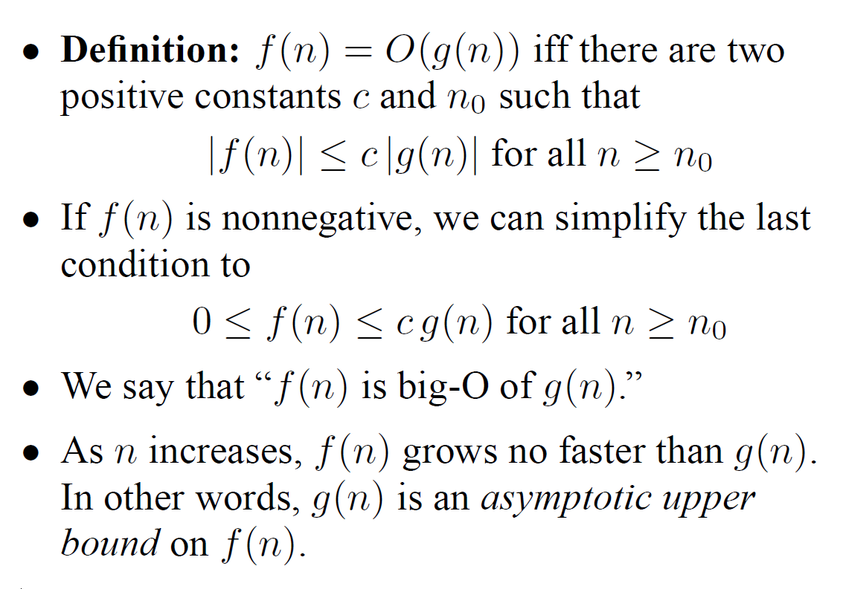
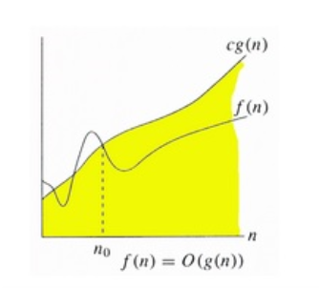

Big O or Big Oh

Slide 14
Big O or Big Oh
For example:
at n>=2 and c = 1

Slide 15
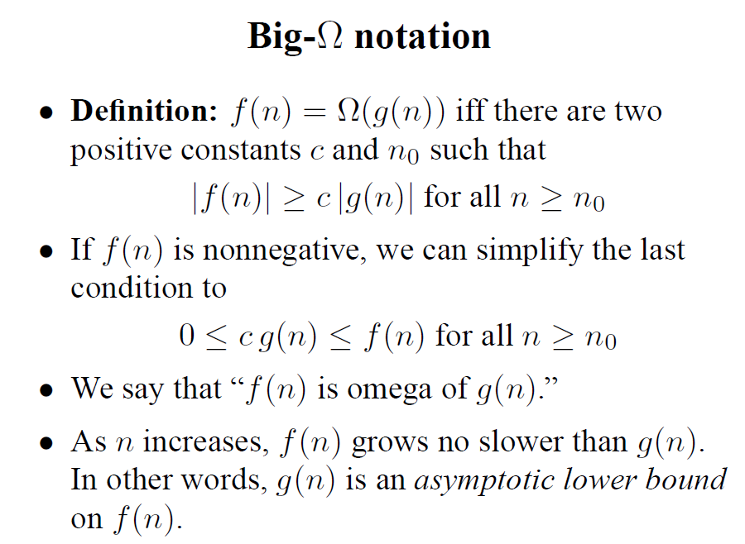
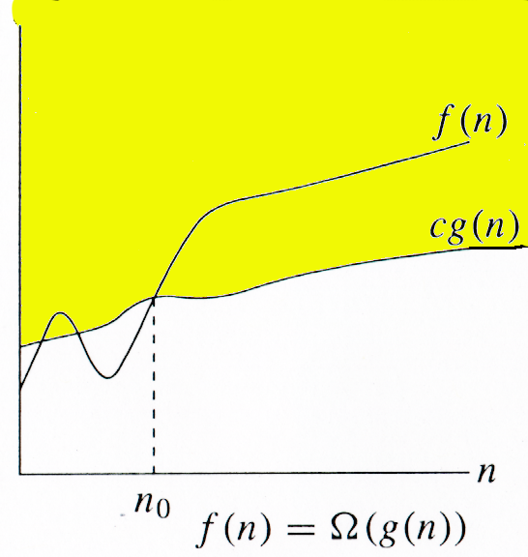
Big Omega

Slide 16

Big Omega
For example:
at n>=1 and c = 1

Slide 17
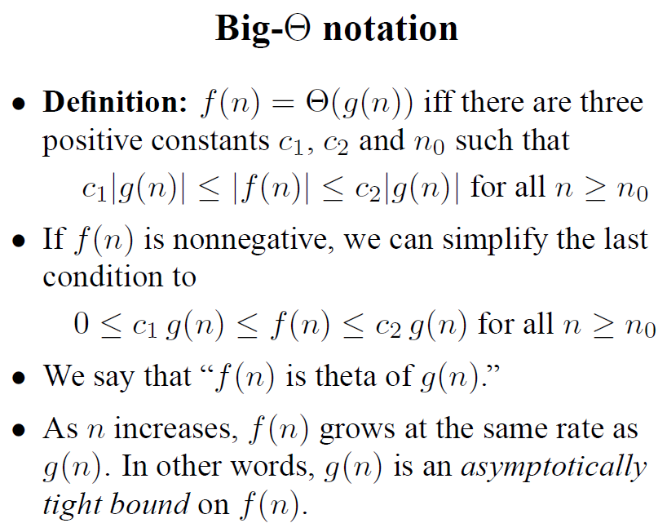
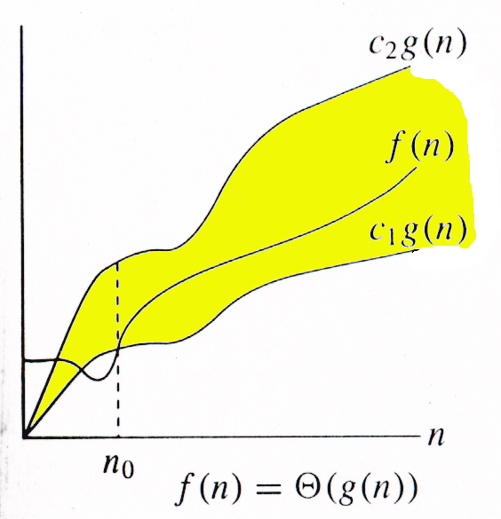
Big Theta

Slide 18

Big Theta
For example:
at n>=1 and c1 = 1 and c2 = 13

Slide 19
Big O, Big Omega, Big Theta

Slide 20
o-notation (small o)
For a given function g(n), the set little-o:
o(g(n)) = {f(n): ∀ c > 0, ∃ n0 > 0 such that ∀ n ≥ n0, we have 0 ≤ f(n) < cg(n)}.
f(n) becomes insignificant relative to g(n) as n approaches infinity:
lim [f(n) / g(n)] = 0
^{n→∞}
g(n) is an upper bound for f(n) that is not asymptotically tight.
Observe the difference in this definition from previous ones.

Slide 21
ω -notation
For a given function g(n), the set little-omega:
w(g(n)) = {f(n): ∀ c > 0, ∃ n0 > 0 such that ∀ n ≥ n0, we have 0 ≤ cg(n) < f(n)}.
f(n) becomes arbitrarily large relative to g(n) as n approaches infinity:
lim [f(n) / g(n)] = ∞.
^{n→∞}
g(n) is a lower bound for f(n) that is not asymptotically tight.

Slide 22
Comparison of Functions
f ↔ g ≈ a ↔ b
f (n) = O(g(n)) ≈ a ≤ b
f (n) = Ω(g(n)) ≈ a ≥ b
f (n) = Θ(g(n)) ≈ a = b
f (n) = o(g(n)) ≈ a < b
f (n) = ω (g(n)) ≈ a > b

Slide 23
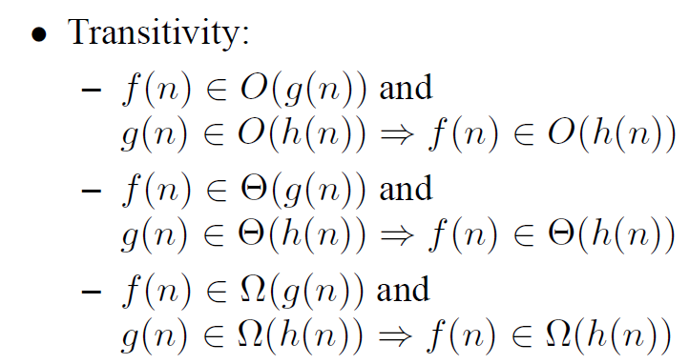

Slide 24
Prove that
We will be covering these type of asymptotic proofs in next classes.

